Slide 1
Software Quality Engineering (SQE)
Test Case Development

Slide 2
STLC - Software Testing Life Cycle Phases
Notes:
https://www.guru99.com/software-testing.html

Slide 3
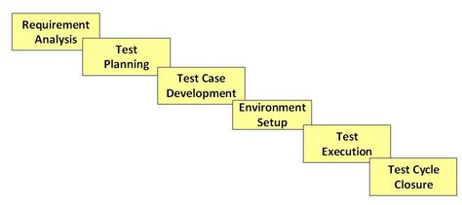
Software Testing Life Cycle (STLC) is defined as a sequence of activities conducted to perform Software Testing.
Contrary to popular belief, Software Testing is not a just a single activity. It consists of a series of activities carried out methodologically which help to certify your software product.

Slide 4
1) Requirement Analysis
During this phase, test team studies the requirements from a testing point of view to identify the testable requirements.
The QA team may interact with various stakeholders (Client, Business Analyst, Technical Leads, System Architects etc.) to understand the requirements in detail.
Requirements could be either Functional (defining what the software must do) or Non Functional (defining system’s quality attributes )

Slide 5
2) Test Planning
Typically, at this stage, a Senior QA manager determines effort and cost estimates for the project and prepare and finalize the Test Plan.
In this phase, Test Strategy is also determined.

Slide 6
3) Test Case Development
This phase involves the creation, verification and rework of test cases & test scripts.
Test data is identified/created and is reviewed and then reworked as well.

Slide 7
4) Test Environment Setup
Test environment decides the software and hardware conditions under which a work product is tested.

Slide 8
5) Test Execution
During this phase, the testers carry out the testing based on the test plans and the test cases prepared.
Bugs are to be reported back to the development team for correction and retesting is be performed.

Slide 9
6) Test Cycle Closure
Testing team meet, discuss and analyze testing artifacts to identify strategies that have to be implemented in the future, taking lessons from the current test cycle.
The idea is to remove the process bottlenecks for future test cycles and share best practices for any similar projects in the future.

Slide 10
Test Documentation in Software Testing
What is Test Documentation?
Notes:
https://www.guru99.com/testing-documentation.html

Slide 11
Test documentation: In writing records of artifacts created before or during the testing of software.
It is a complete suite of documents that allow you to describe and document test planning, test design, test execution, test results that are drawn from the testing activity.

Slide 12
Test Documentation in Software Testing
Metrics of Test Documentation

Slide 13
Testing Metric | Description
Test policy | It is a high-level document which describes principles, methods and all the important testing goals of the organization.
Test strategy | A high-level document which identifies the Test Levels/Types to be executed for the project.
Test plan | A test plan is a complete planning document which contains the scope, approach, resources, schedule, etc. of testing activities.
Requirements Traceability Matrix | This is a document which connects the requirements to the test cases and vice versa
Test Scenario | Test scenario is module or sub-module of a software system which could be verified by one or more Test cases.

Slide 14
Testing Metric | Description
Test Case | It is a group of input values, execution preconditions, expected execution post-conditions and results. It is developed for a Test Scenario.
Test Data | Test Data is a data which is used to execute the test case.
Defect Report | Defect report is a documented report of any flaw in a Software System which fails to perform its expected function.
Test Summary Report | Test summary report is a high-level document which summarizes testing activities conducted as well as the test result. It is also referred as Test Closure Report

Slide 15
What is Test Scenario?
What is Scenario Testing?
Notes:
https://www.guru99.com/test-scenario.html

Slide 16
A Test Scenario is defined as any functionality that can be tested. It is also called Test Condition or Test Possibility.
Scenario Testing is a variant of Software Testing where Scenarios are used for Testing.
Scenarios help in an Easier Way of Testing of the more complicated Systems.

Slide 17
What is Test Scenario?
How to Write Test Scenarios?

Slide 18
As a tester, you can follow these five steps to create Test Scenarios-
Read the Requirement Documents of the System Under Test (SUT).
For each requirement, figure out possible users actions and objectives. Determine the technical aspects of the requirement. with hacker's mindset.
After reading the Requirements Document and doing your due Analysis, list out different test scenarios that verify each feature of the software.
Once you have listed all possible Test Scenarios, a Traceability Matrix is created to verify that each & every requirement has a corresponding Test Scenario/Test Case(s).
The scenarios created are reviewed by your supervisor. Later, they are also reviewed by other Stakeholders in the project.

Slide 19
What is Test Scenario?
Example: Test Scenario for e-commerce Application

Slide 20
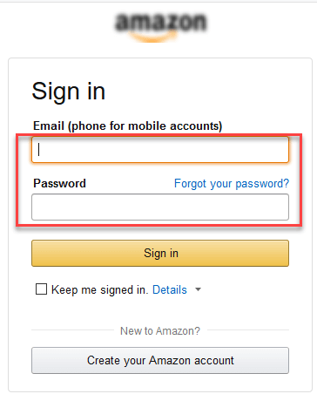
For an eCommerce Application, a few test scenarios would be
Test Scenario 1: Check the Login Functionality

Slide 21
Possible Test Cases against the Test Scenario 1 would be:
TC_1.1: Check system behavior when valid email id and password is entered.
TC_1.2: Check system behavior when invalid email id and valid password is entered.
TC_1.3: Check system behavior when valid email id and invalid password is entered.
TC_1.4: Check system behavior when invalid email id and invalid password is entered.
TC_1.5: Check system behavior when email id and password are left blank and Sign in entered.
TC_1.6: Check Forgot your password is working as expected
TC_1.7: Check system behavior when valid/invalid phone number and password is entered.
TC_1.8: Check system behavior when "Keep me signed" is checked

Slide 22

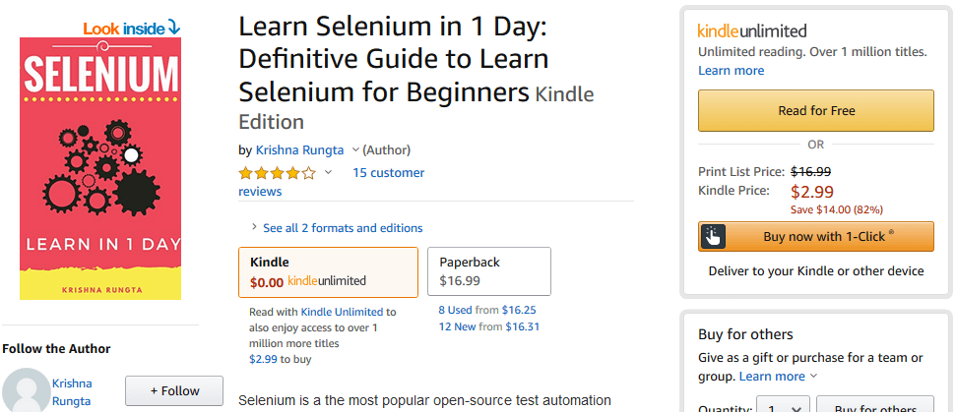
Test Scenario 2: Check the Search Functionality
Test Scenario 3: Check the Product Description Page

Slide 23
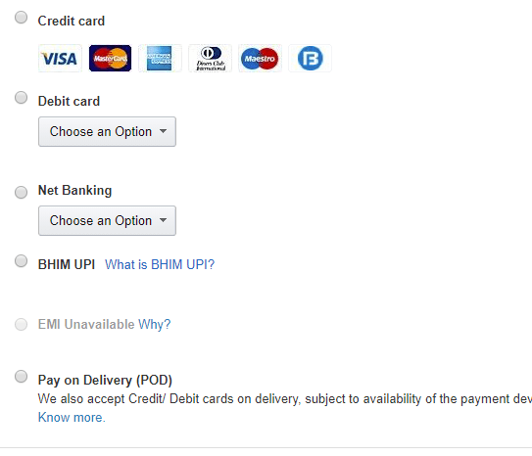
Test Scenario 4: Check the Payments Functionality

Slide 24
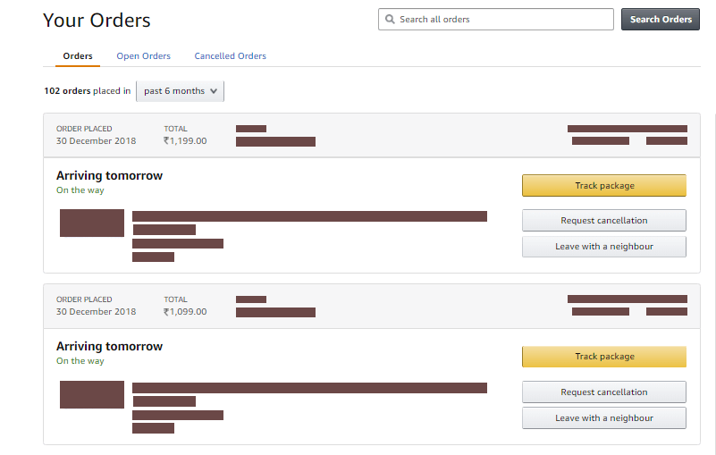
Test Scenario 5: Check the Order History

Slide 25
Apart from these 5 scenarios here is the list of all other scenarios
6. Check Home Page behavior for returning customers
7. Check Category/Product Pages
8. Check Customer Service/Contact Pages
9. Check Daily Deals pages

Slide 26
Class Activity 4: Write Test Case for a Test Scenario
You can do it either individually or can make a group of 2-4 people.
Tear a page out and write your course name and section, complete ID, and full name on it.
Statement: Visit Next Slide

Slide 27
Class Activity 4: Write Test Case for a Test Scenario
Statement: Identify two unique test cases against each payment option mentioned in the GUI given below.
Write Test case ID and Test Case Description only.

Slide 28
Class Activity 4: SOLUTION
For the payment method Credit Card:
TC_1.1: Check the system behavior when radio button of credit card is clicked and VISA card option is selected.
TC_1.2: Check the system behavior when radio button of credit card isn’t clicked and customer tries to select ‘master card’ option.
For the payment method Debit Card:
TC_1.3: Check the system behavior when radio button of debit card is clicked and a valid card option is selected from the dropdown list.
TC_1.4: Check the system behavior when radio button of debit card isn’t clicked and customer tries to select a valid card option from dropdown list.

Slide 29
How to Write Test Cases?
What is a Test Case?
Test Scenario Vs Test Case

Slide 30
A Test Case is defined as a set of actions executed to verify a particular feature or functionality of the software application.
Test Scenario Vs Test Case
For a Test Scenario like: Check Login Functionality, there are many possible test cases:
Test Case 1: Check results on entering valid User Id & Password
Test Case 2: Check results on entering Invalid User ID & Password
Test Case 3: Check response when a User ID is Empty & Login Button is pressed, and many more……

Slide 31
How to Write Test Cases?
How to Create a Test Case?

Slide 32
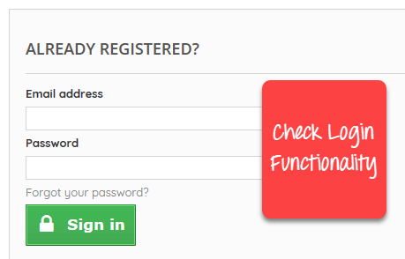
Let’s create a Test Case for the scenario: Check Login Functionality

Slide 33
Step 1) A simple test case for the scenario would be:
Step 2) In order to execute the test case, you would need Test Data. Adding it below:
Test Case ID | Test Case Description
TC_1.1 | Check the system behavior when valid email and password are entered
Test Case ID | Test Case Description | Test Data
TC_1.1 | Check the system behavior when valid email and password are entered | Email: abc_xyz@email.com Password: lNf9^Oti7^2h

Slide 34
Step 3) In order to execute a test case, a tester needs to perform a specific set of actions on the AUT. This is documented as below:
Step 4) The goal of test cases is to check behavior the AUT for an expected result. This needs to be documented as below
Test Case ID | Test Case Description | Test Steps | Test Data
TC_1.1 | Check the system behavior when valid email and password are entered | 1. Go to site: http://demo.com 2. Enter Email 3. Enter Password 4. Click Submit | Email: abc_xy@email.com Password: lNf9^Oti7^2h
Test Case ID | Test Case Description | Test Data | Expected Result
TC_1.1 | Check the system behavior when valid email and password are entered | Email: abc_xyz@email.co Password: lNf9^Oti7^2h | Login should be successful

Slide 35
During test execution time, the tester will check expected results against actual results and assign a pass or fail status.
Test Case ID | Test Case Description | Test Data | Expected Result | Actual Result | Pass/Fail
TC_1.1 | Check the system behavior when valid email and password are entered | Email: abc_xyz@email.com Password: lNf9^Oti7^2h | Login should be successful | Login was successful | Pass

Slide 36
Step 5) Your test case -may have a field like:
Pre - Condition Preconditions define prerequisites that must be met before the system can begin executing the test case.
Preconditions could describe the system state (for a test case to withdraw cash from an automated teller machine, the ATM must contain money), but they don’t describe the user’s intent (“I need some cash”).
For our test case, a pre-condition would be to the user must have signed up.

Slide 37
Step 5) Your test case -may have a field like:
A test case may also include Post - Conditions which specifies anything that applies after the test case completes successfully. Post-conditions can describe:
Something observable to the user (in the case of ATM cash withdrawal; the system displayed an account balance).
Physical outcomes (the ATM has dispensed money and printed a receipt).
Internal system state changes (the account has been debited by the amount of a cash withdrawal, plus any transaction fees)
For our test case, a post-condition would be time & date of login stored in the database.

Slide 38
How to Write Test Cases?
The format of Standard Test Cases

Slide 39
Test Case ID | Test Description | Test Steps | Test Data | Expected Results | Actual Results | Pass/Fail
TC_1.1 | Check the system behavior when valid email and password are entered | 1. Go to site: http://demo.com 2. Enter E-mail 3. Enter Password 4. Click Submit | E-mail = abc_xyz@email.com Password = pass_abc_xyz | User should Login into an application | As Expected | Pass
TC_1.2 | Check the system behavior when invalid email and password are entered | 1. Go to site http://demo.com 2. Enter E-mail 3. Enter Password 4. Click Submit | E-mail= abc_xyz Password = pass_abcxyz1212 | User should not Login into an application | As Expected | Pass
This entire table may be created in Word, Excel or any other Test management tool. That's all to Test Case Design

Slide 40
Test Case Template Formats
Test case fields and description

Slide 41
A good Test Case template maintains test artifact consistency for the test team and makes it easy for all stakeholders to understand the test cases.
The template chosen for your project depends on your test policy. Many organizations create test cases in Microsoft Excel while some in Microsoft Word. Some even use test management tools like HP ALM to document their test cases.
Irrespective of the test case documentation method chosen, any good test case template must have the following fields:

Slide 42
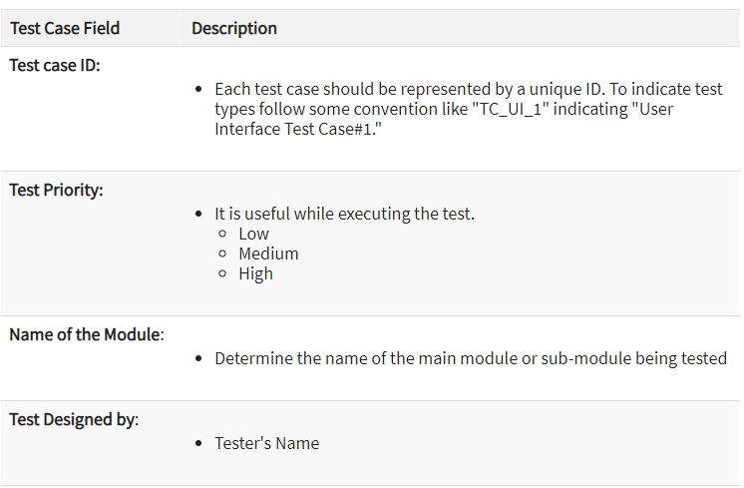

Slide 43
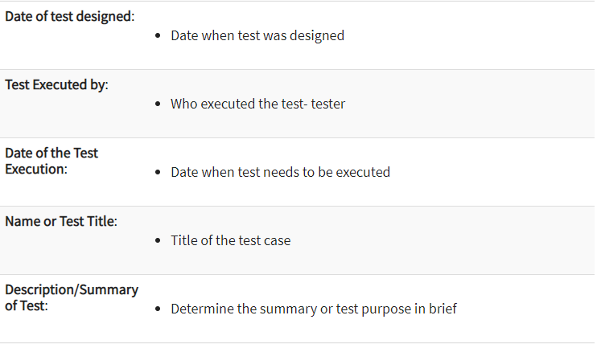

Slide 44
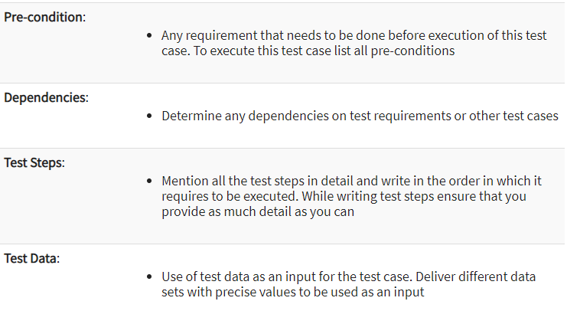

Slide 45
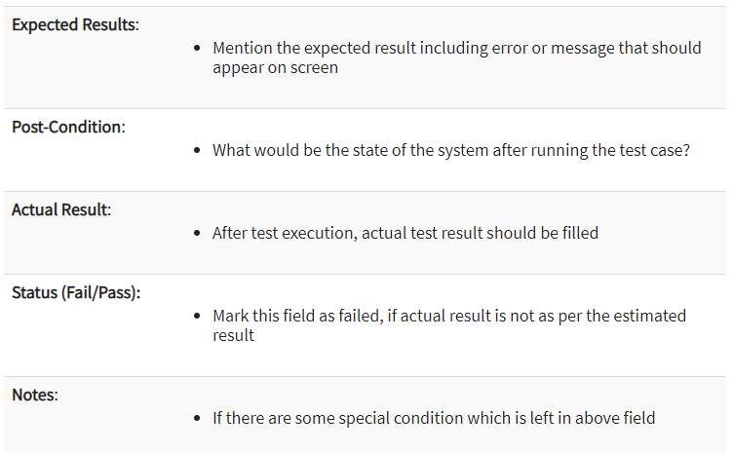

Slide 46
How to Write Test Cases?
Best Practice for writing good Test Case
Test-Case Template Document

Slide 47
1. Test Cases need to be simple and transparent
2. Create Test Case with End User in Mind
3. Avoid test case repetition
4. Do not Assume
5. Ensure 100% Coverage
6. Test Cases must be identifiable
7. Implement Testing Techniques
8. Peer Review
Test-Case Template Document

Slide 48
Class activity 3: Write test cases Formally
You can do it either individually or can make a group of 2-4 people.
Tear a page out and write your course name and section, complete ID, and full name on it.
Statement: Visit Next Slide

Slide 49
Class activity 3: Write test cases Formally
Take into consideration the following figure (Check the Search Functionality) and write two unique test cases as per the format mentioned.
Format: Test Case ID, Test Description, Test Steps, Test Data, Pre-condition (the most important one), Post-condition (the most important one), Expected Results, Actual Results, Status

Slide 50
What is Test Analysis (Test Basis) in Software Testing?

Slide 51
Test Analysis is the process of looking into software artifacts (documentation) to base your test conditions/test cases. Hence, it is also called Test Basis.
The source from which you derive test information could be:
SRS (Software Requirement Specification)
BRS (Business Requirement Specification)
Functional Design Documents
Testers can create Test Conditions by looking into the Application Under Test or use their experience. But mostly, test cases are derived from software artifacts (documentation).

Slide 52
What is Test Analysis (Test Basis) in Software Testing?
Test Analysis: A case study

Slide 53
Consider a scenario, where the client sends the following requirement
Add search functionality to an eCommerce Store
Even though the application is yet to be developed, try and develop a few test cases for this requirement.
A few test cases among the many you could have thought of are listed below
Check the search results when no keyword(s) is entered
Check the search results when no corresponding product is available for the keyword(s) searched
Check the search results when a number of corresponding products are available for the keyword(s) searched
Here, you look into Test Basis (requirement send by the client), analyze it, and convert it into Test Conditions.

Slide 54
What is Requirements Traceability Matrix (RTM)?

Slide 55
Requirement Traceability Matrix or RTM captures all requirements proposed by the client or software development team and their traceability in a single document delivered at the conclusion of the testing life-cycle.
In other words, it is a document that maps and traces user requirement with test cases and vice versa.
The main purpose of Requirement Traceability Matrix is to see that all test cases are covered so that no functionality should miss while doing Software testing.

Slide 56
What is Requirements Traceability Matrix (RTM)?
Which Parameters to include in Requirement Traceability Matrix?

Slide 57
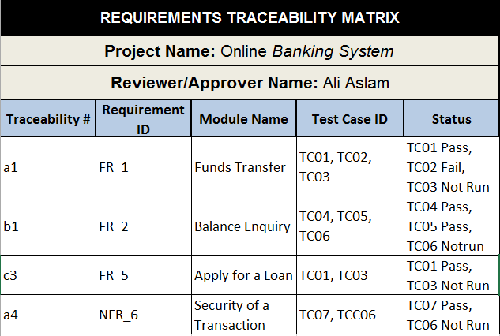

Slide 58
What is Requirements Traceability Matrix (RTM)?
Types of Traceability Matrix
Notes:
https://www.softwaretestinghelp.com/requirements-traceability-matrix/

Slide 59
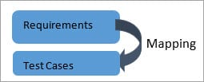

Forward Traceability: In ‘Forward Traceability’ Requirements are mapped to the Test cases. It ensures that the project progresses as per the desired direction and that every requirement is tested thoroughly.
Backward Traceability: The Test Cases are mapped with the Requirements. Its main purpose is to determine that no extra unspecified functionalities are added.

Slide 60
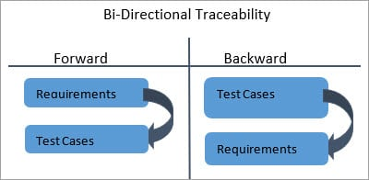
Bi-Directional Traceability (Forward + Backward): A Good Traceability matrix has references from test cases to requirements and vice versa (requirements to test cases). This is referred to as ‘Bi-Directional’ Traceability. It ensures that all the Test cases can be traced to requirements and each and every requirement specified has accurate and valid Test cases for them.

Slide 61
What is Requirements Traceability Matrix (RTM)?
How to create Requirement Traceability Matrix?

Slide 62
Let's understand the concept of Requirement Traceability Matrix through a Online Banking Project.
Let suppose, the following table is our Business Requirement Document or BRD for online banking project.
Here the scenario is that the customer as well as manager shall be able to login to the banking website with the correct password and user id through login page.

Slide 63
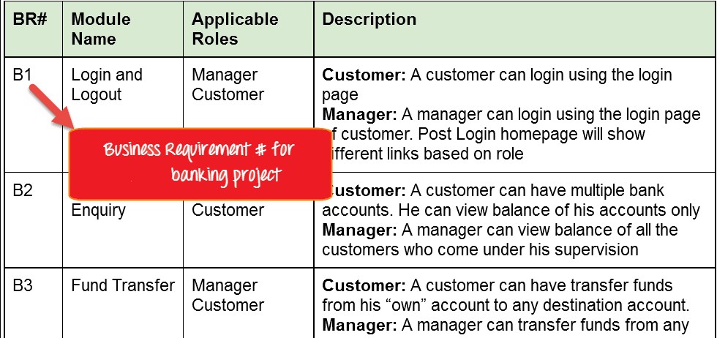

Slide 64
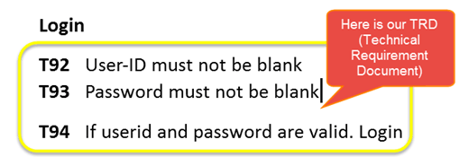
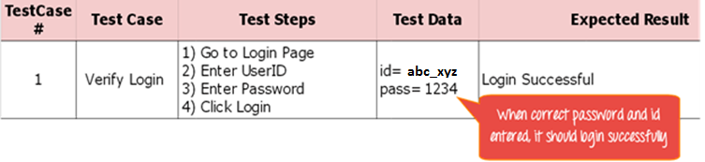
While the below image is our Technical Requirement Document (TRD).
Let's Go Ahead and create RTM in Testing
Step 1: Our sample Test Case is:
"Verify Login, when correct ID and Password is entered, it should log in successfully"

Slide 65
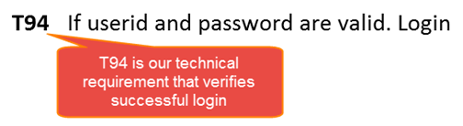
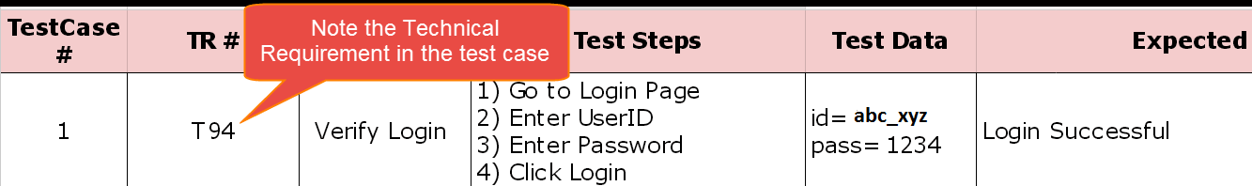
Step 2: Identify the Technical Requirement that this test case is verifying. For our test case, the technical requirement is T94 is being verified.
Step 3: Note this Technical Requirement (T94) in the Test Case.

Slide 66
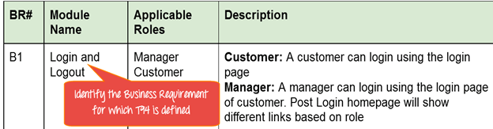
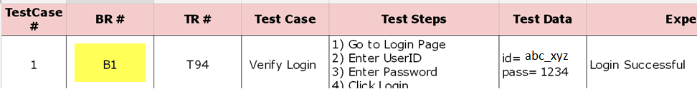
Step 4: Identify the Business Requirement for which this TR (Technical Requirement-T94) is defined.
Step 5: Note the BR (Business Requirement) in Test Case
Step 6: Do above for all Test Cases. RTM in testing is Ready!

